Slide 1

MAKING
RATIONAL NUMBERS
MORE MEANINGFUL
ATMIM WINTER CONFERENCE
BOSTON COLLEGE
JANUARY 9 2014
Margaret J. Kenney (kenney@bc.edu)
Boston College, Chestnut Hill MA 02467

Slide 2
Factors
Common Core Treatment
Of the Rationals
Pre-service teachers
Bias about Number Line
Use

Slide 3
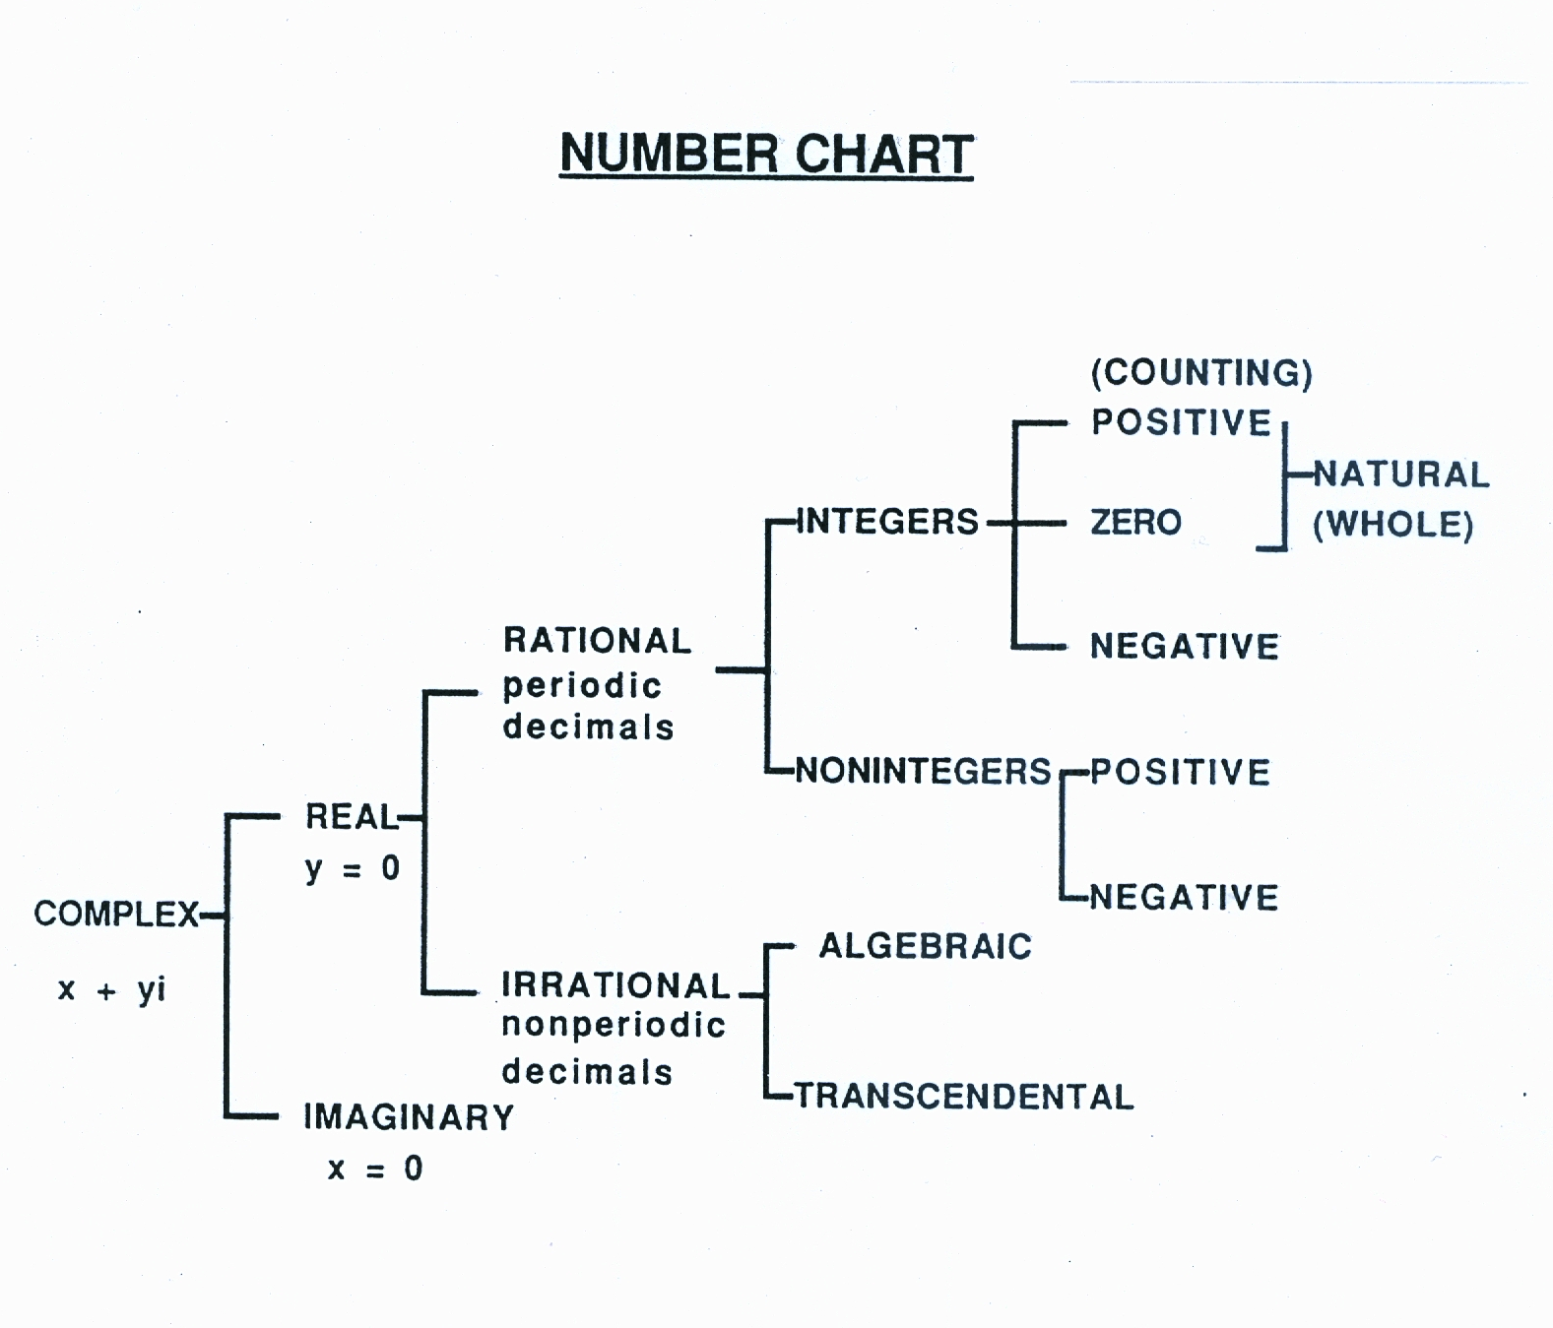

Slide 4
Unit Fractions are key to the development of rational numbers in CCSSM
What of unit fractions in math history?

Slide 5
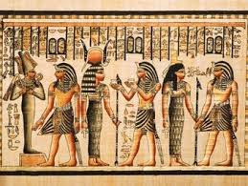
Solve: Divide L loaves
Among P persons
Equally using ‘largest unit fractions’ .

Slide 6
OUR SOLUTION ?

Slide 7
OUR SOLUTION ?
4 ÷ 7
4 / 7

Slide 8
EGYPTIAN SOLUTION

Slide 9
EGYPTIAN SOLUTION

Slide 10
TRY
Divide 3 loaves
Among 7 persons

Slide 11
EGYPTIAN SOLUTION

Slide 12
EGYPTIAN SOLUTION

Slide 13
EGYPTIAN SOLUTION

Slide 14
EGYPTIAN SOLUTION

Slide 15
Key relation for
Rational numbers
Equality
Given: a /b = c /d
if and only if
ad = bc

Slide 16
WHY ??

Slide 17
a /b = c /d
if and only if
ad/bd = bc/bd
implies ad = bc

Slide 18
a /b = c /d
if and only if
ac/bc = ac/ad
implies ad = bc

Slide 19
WHY ??
SAME
DENOMINATORS
OR
NUMERATORS

Slide 20
A Ready-to-Use Fraction Tool

Slide 21
Try
Number tiles
Useful in
Problem Solving

Slide 22
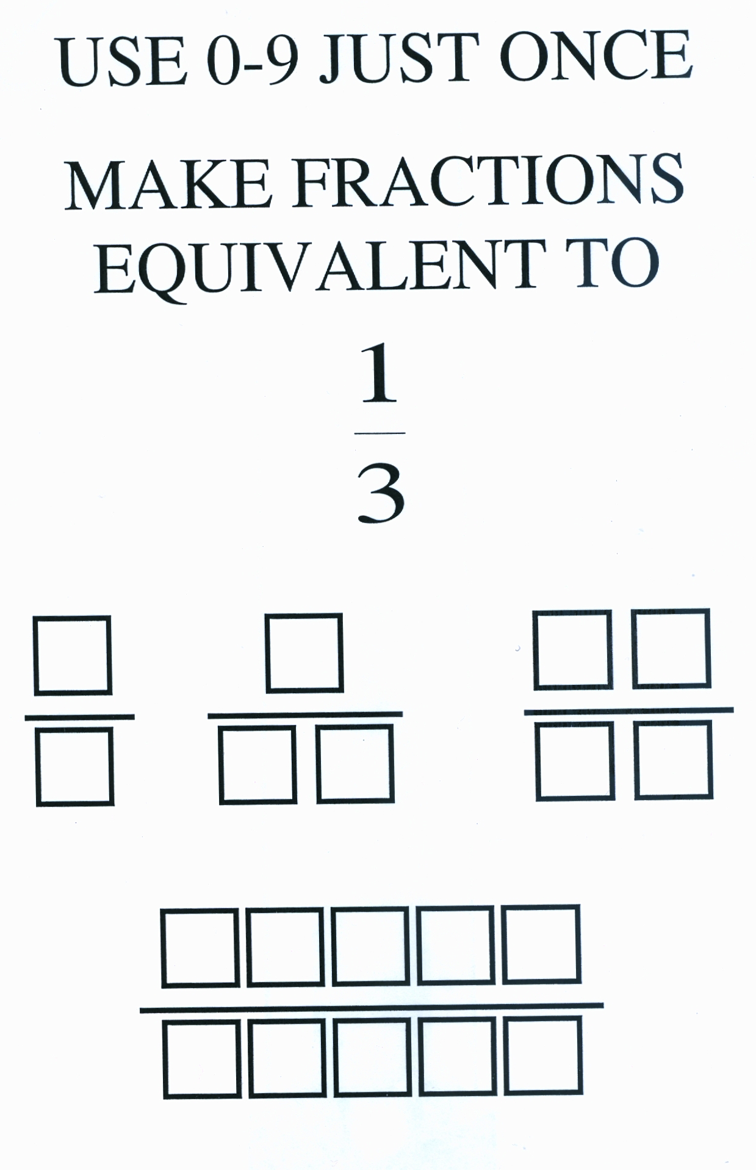

Slide 24
1
2
3
3
6
9

Slide 25
How Many like

Slide 26
How many like

Slide 27
CHALLENGE

Slide 28
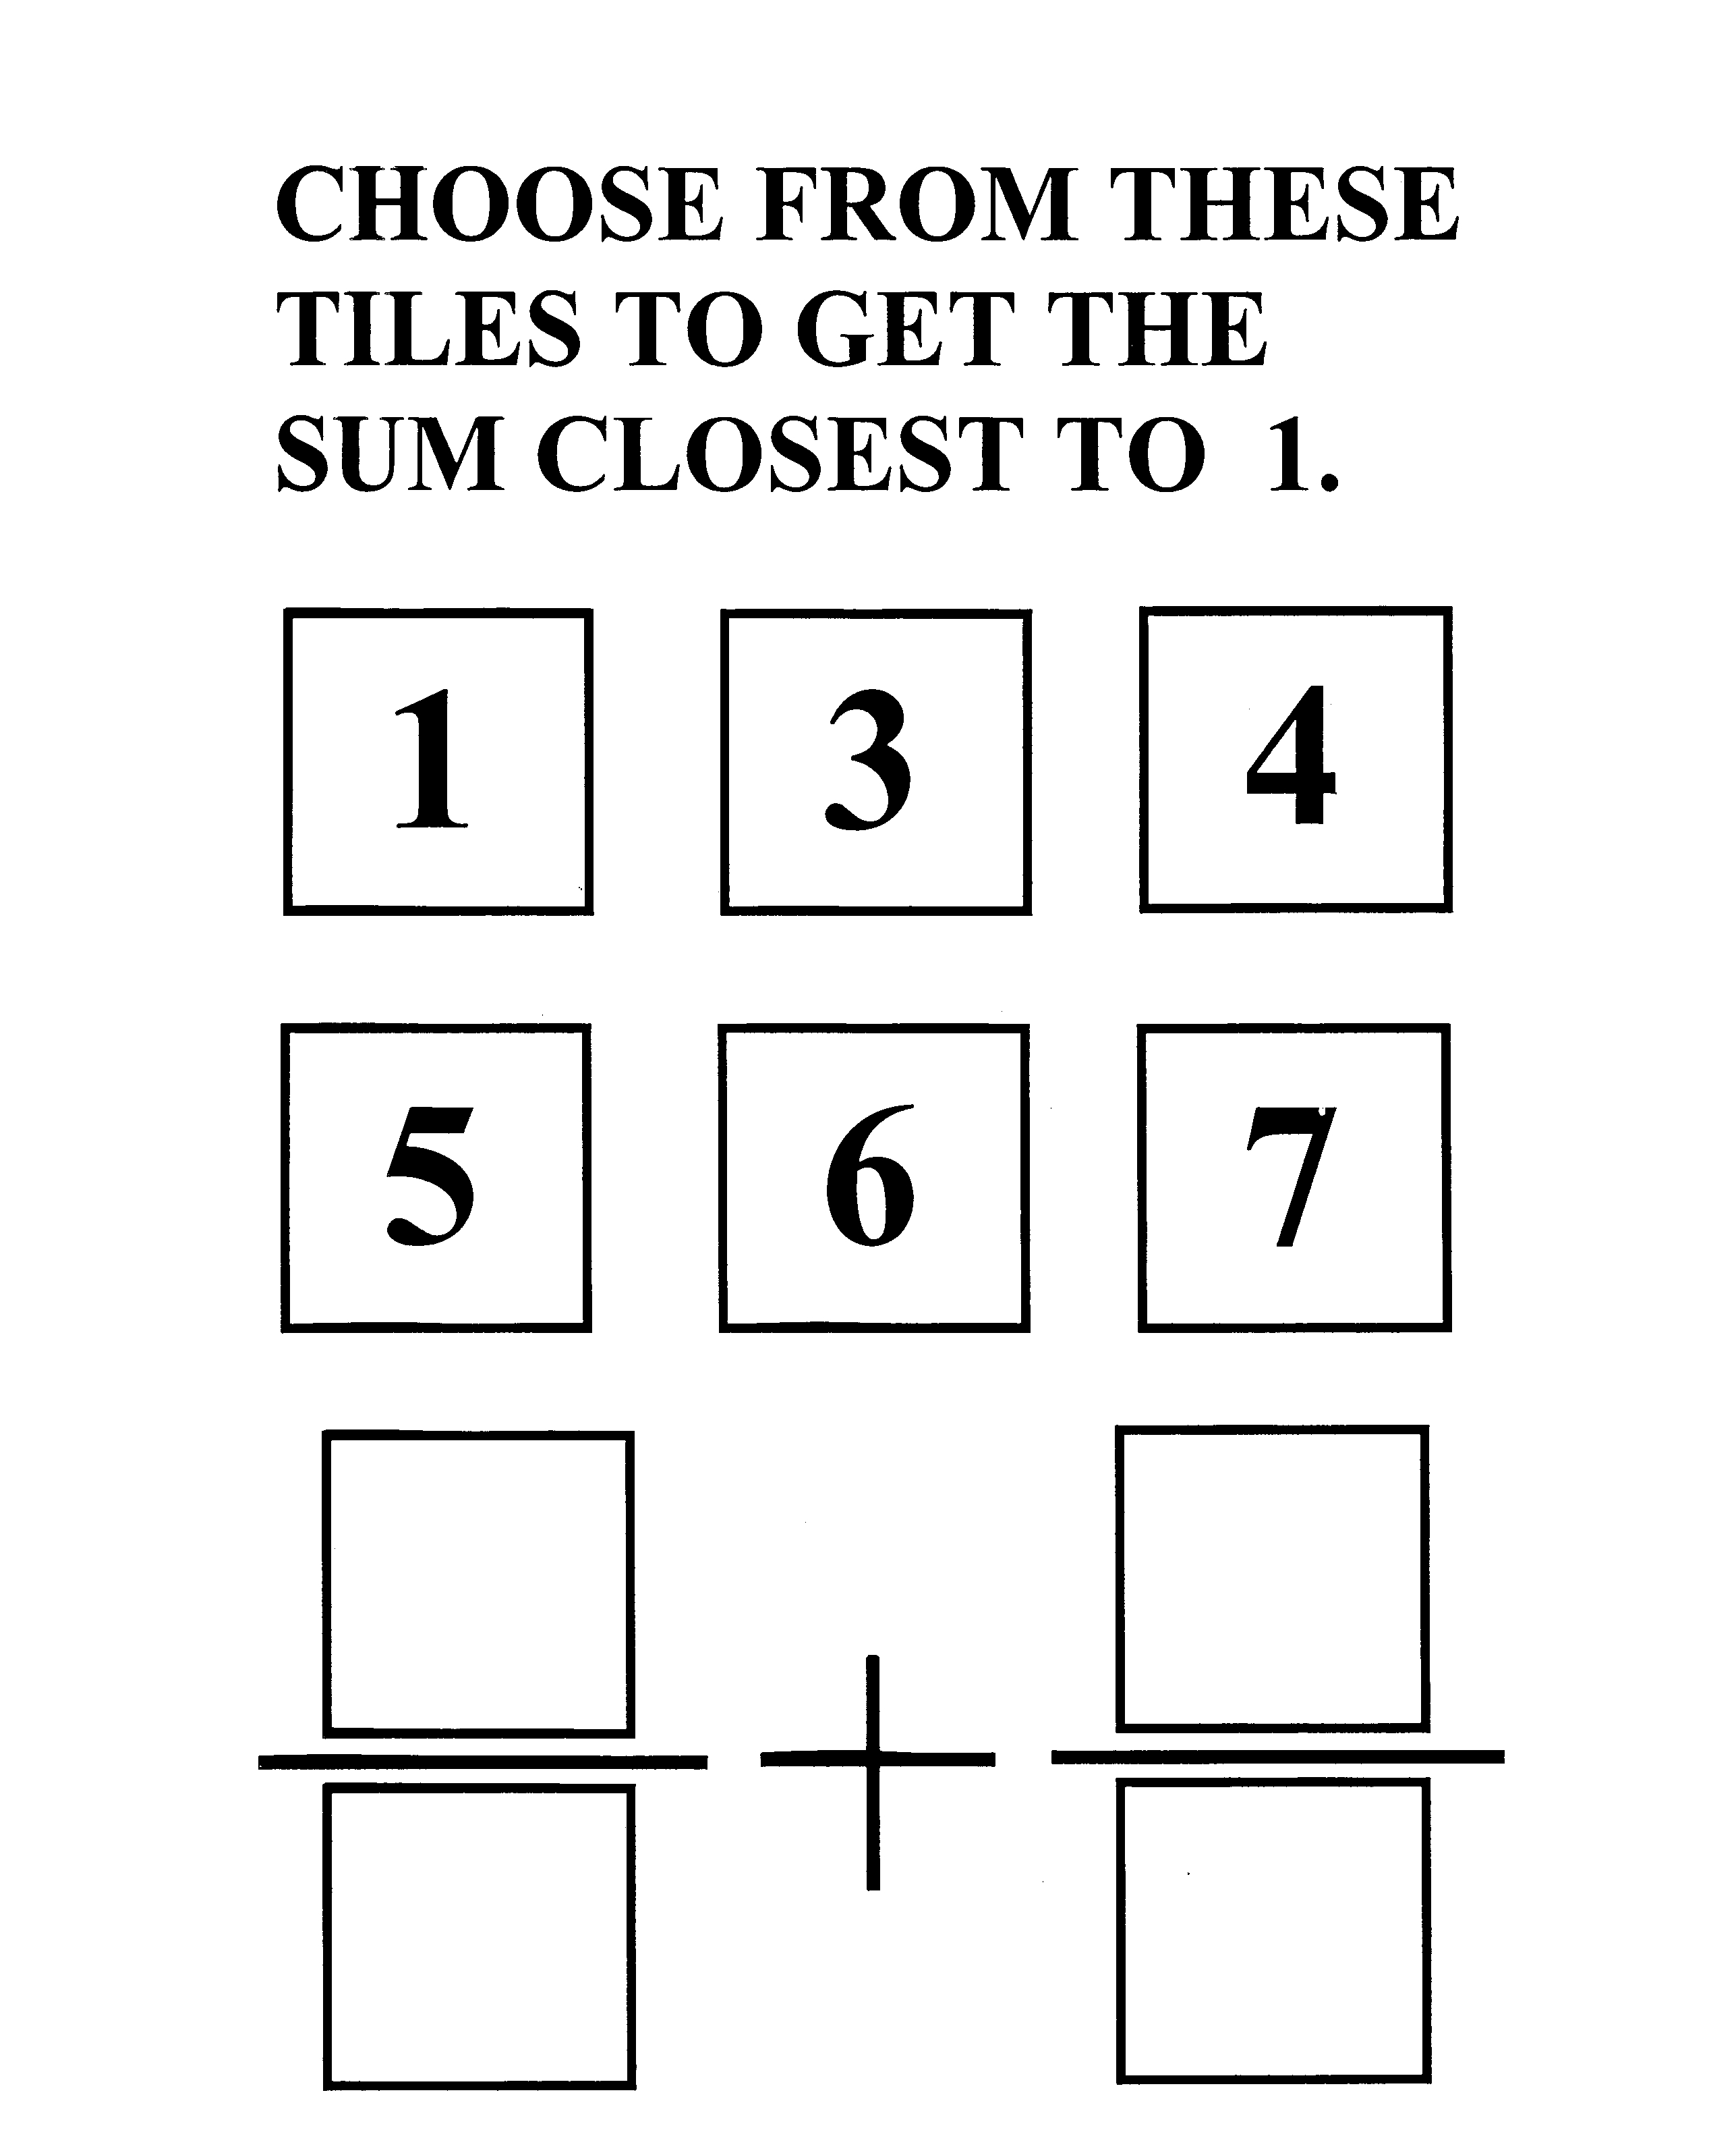

Slide 29
Points to Ponder:
What is largest/smallest sum?
Closest means?
How many pairs ? Sums?

Slide 30
The Power of the Number Line
a/b
c/d

Slide 32
Find a Rational Number between two Rational Numbers

Slide 33
Find a Rational Number between two Rational Numbers
NAME THREE WAYS TO ACCOMPLISH THIS

Slide 34
Averaging
Halve the distance
Add /Subtract

Slide 35
Given: 1 /4 and 2 /3
Between: (1+ 2) / (4 +3) ? ?

Slide 36
Given: 1 /4 and 2 /3
Is (1+ 2) / (4 +3) between them ? ?
Try other examples

Slide 37
What about
1 /5 and 3 /4
Between: (1+ 3) / (5 +4) ? ?
3 /8 and 5 /4
Between: (3+ 5) / (8 + 4) ? ?

Slide 38
CONJECTURES
With
Rational Numbers

Slide 39
CONJECTURE -
Given: a /b and c /d
then (a+ c) / (b + d) is between them

Slide 40
Key relation to apply
Less than

Slide 41
Key relation to apply
Less than
Given: a /b < c /d
if and only if
ad < bc

Slide 42
Given: a /b < c /d
Show a /b < (a+ c) / (b + d) and (a+ c) / (b + d) < c /d

Slide 43
Algorithms /Operations
With
Rational Numbers

Slide 44
Addition
a c ad bc
b d bd bd
ad + bc
bd
+
=
+
=

Slide 45
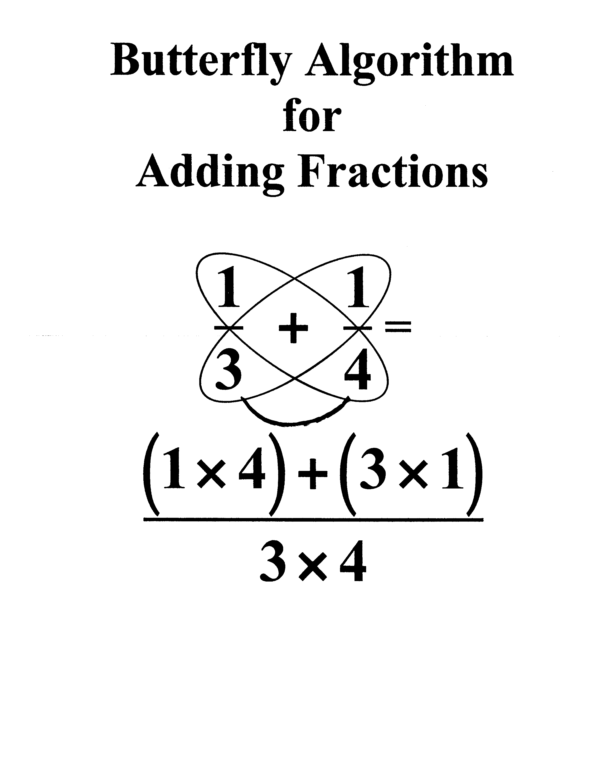

Slide 47
Multiplication
a c a x c
b d b x d
x
=

Slide 48
Division
Invert & Multiply
a c a d
b d b c
÷
=

Slide 49
Division
Is this valid?
a c a ÷ c
b d b ÷ d
÷
=

Slide 50
Is this valid?
a ÷ c a/c
b ÷ d b/d
(a/c )(d/b)
(b/d)(d/b)
ad
bc
=
=
=

Slide 52
How would you find all rational numbers with a specified denominator be- tween 2 given rationals?
Describe procedure

Slide 53
Suppose the two rational numbers are
1/4 and 5/6 and the denominator is 15.

Slide 54
Relation < is key
1/4 < 4/15 as 15 <16
12/15 < 5/6 as 72 < 75

Slide 55
Relation < is key
1/4 < 4/15 as 15 <16
12/15 < 5/6 as 72 < 75
4/15, 5/15, …. 11/15, 12/15

Slide 56
A Mathematical System
Organizer
Elements
Definitions & Relations
Operations
UnProved Statements/ Assumptions
Proved Statements/
Theorems

Slide 57
A Mathematical System
Rational Numbers
Elements : Numbers of form a/b where a,b are integers and b≠0.
Definitions & Relations:
Include =, <, >, …
Operations: +, −, x, ÷

Slide 58
A Mathematical System
Rational Numbers
UnProved Statements/ Assumptions for +, x
Closure, Commutative, Associative, Identity,
Inverses, Distributive
Proved Statements/
Theorems

